Slide 1
From Moscow to Havana and back:
Notes on the Soviet–Cuban sentimental community
Damaris Puñales–Alpízar

Slide 2
Escrito en cirílico: el ideal soviético en la cultura cubana posnoventa
Santiago de Chile: Editorial Cuarto Propio, 2012.
Damaris Puñales–Alpízar

Slide 3
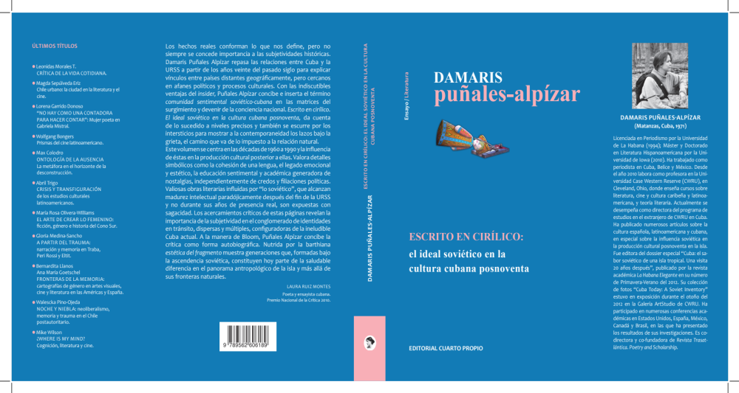

Slide 4
Written in Cyrillic: the Soviet Ideal in the Cuban Cultural Production After the 90s.
In my book, I explore how the concepts of collective memory, identity and post–socialist nostalgia are redefined in Cuba after the end of the Soviet Union through cultural production, and how these reconfigurations are intertwined into the presence of Soviet culture in the Cuban daily life during at least thirty years, from the 60s to the 90s.

Slide 5
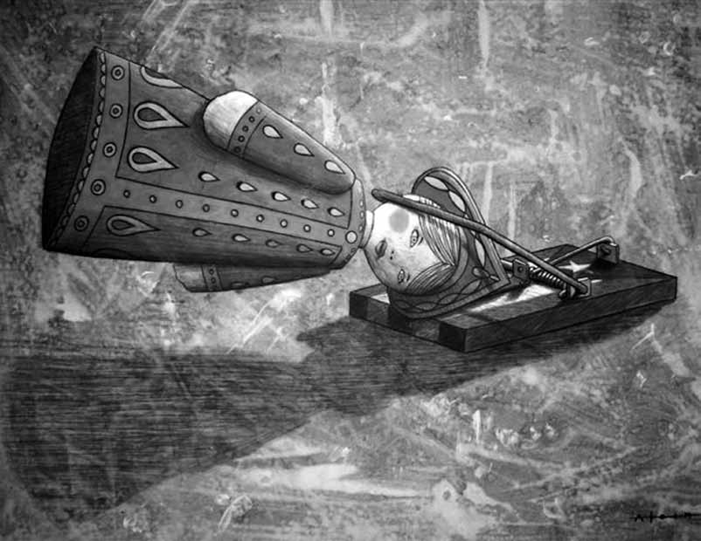

Slide 6
Index
Acknowledgements…………………………………………………………………………………….11
Initial Statement………………………………………………………………………………………………15
Post–national Confessions……………………………………………………………………………………………..19
Introduction……………………………………………………..………………………………….…25
Chapter I: Narrating the Utopia: Tropical Socialist Realism. Analysis of La última mujer y el próximo combate, by Manuel Cofiño; and Con tu vestido blanco, by Félix Luis Viera………………………………………………….………………………………………….47
Chapter II: Snowing on Havana: Soviet Traces in post–90 literary Cuba………………109
Chapter III: Impossible Transculturation: Race and Sex in Cuban–Soviet relations…165
Chapter IV: Snow Roads. Soviet Representation and Appropriation in Jesús Díaz and Manuel Prieto’s trilogies…………………………………………………………………………….183

Slide 7
Chapter V: Emerio Medina, Reynaldo González and Alexis Díaz Pimienta: Post–Soviet Paratextualities and Intertextualities…….…………………………………...215
Chapter VI: Searching for the Soviet through a lens’ camera………………….….229
Chapter VII: Soy Cuba, Océano and Lisanka: From Allegory to Daily Life’s Experiences. Ideological and Aesthetic changes in Cuban–Soviet–Russian cinematographic co–productions…………………………………………………………277
Chapter VIII: On Soviet Materiality in Cuba, its traces and implications. Notes for a reflection……………………………………………………………………………….311
Preliminary Conclusions………………………………………………………………….355
Bibliography…..…………………………………………………………………………….367

Slide 8
Authors analyzed:
Manuel Cofiño
Félix Luis Viera
Anna Lidia Vega Serova
Jesús Díaz
Adelaida Fernández de Juan
Gleyvis Coro Montanet
Antonio José Ponte
José Manuel Prieto
Alexis Díaz Pimienta
Reynaldo González
Emerio Medina

Slide 9
Audiovisuals:
9550, by Ernesto René
Good bye, Lolek, by Asori
Todas iban a ser reinas (Destinated to be Queens), by Gustavo Pérez and Oneyda González
Lazos (Bonds), by Yosvany Albelo Sandarán
20 años (20 Years), by Bárbaro Joel Ortiz
Pravda, by Eduardo del Llano
Soy Cuba (I am Cuba), by Mikhail Kalatozov
Océano (Ocean), by Mikhail Kosyrev–Nesterov
Lisanka, by Daniel Díaz
Larga distancia (Long Distance), by Esteban Insausti.

Slide 10
The presence of Soviet aesthetics and symbols in Cuban literature and cinema from the 90s to the present appears not just as physical traces but also as the representation of a nostalgic space and as the allegory of an identity in transition. I argue that after the collapse of the Soviet Union, a group of Cuban authors experienced a sense of nostalgia linked to the loss of a collective memory constructed when their nation thrived as an ideological partner of the Soviet Union. I also argue that despite the fact that the Communist Party continues to hold power, Cuba is –since the de-penalization of American currency in 1993– a post-socialist country. These circumstances contributed to the emergence of a ‘sentimental Cuban-Soviet imagined community’, which despite ideological differences among its members, retains a common focal point: its childhood and its memories.

Slide 11
The thirty years of strong relationship between the former Soviet Union and Cuba, from the 60s to the 90s, facilitated the emergence of a “sentimental Soviet–Cuban community” capable to recognize itself as unique and unrepeatable: a generation of Cubans educated within Russian referents: learning Russian language at schools, watching Soviet movies and cartoons and even surrounded by a Russian materiality. In my book, Escrito en cirílico: el ideal soviético en la cultura cubana posnoventa (Cuarto Propio, 2012) I analyze –through literary works, cinema and materiality– how this grammar of the Soviet Cuba allows us to deconstruct cultural, symbolical and affective structures that support a Cuban artistic production where it is possible to find Soviet traces.

Slide 12
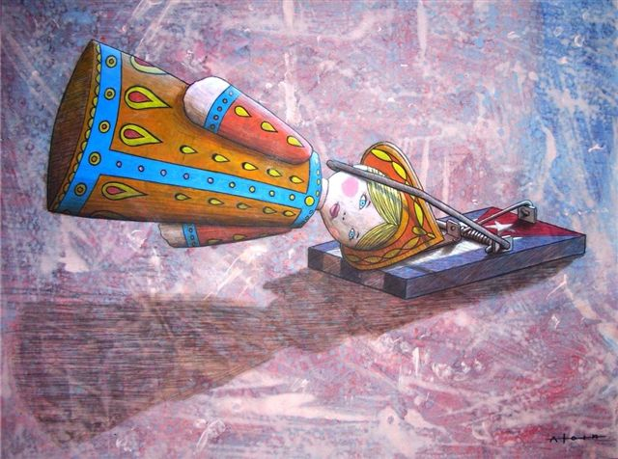

Slide 13
Previous painting by Alain Martínez
Title: “Sujetos” (“Subjects”)
Técnica mixta sobre cartulina. 50 x 70 cm. (Mixed media on cardboard. 50 x 70 cm)

Slide 14
I wanted to start my presentation today with this image for two main reasons: first, it is representative of the sentimental Soviet–Cuban community. His author, Alain Martínez, was born in Cuba in 1973. He recognizes that there is a Soviet influence in his work: “Almost all the information we received was from the Soviet Union”. This painting was shown as part of an art exhibition in Cienfuegos in November–December 2011 with the works from other four plastic artists, all related to the Soviet topic. The name of the exhibition was “Da Kantzá”, which means “up to the end”, in Russian.
According to Camilo Villalvilla, one of the artists, they decided to call it like this because it was the way that Cubans had to absorb the Soviet/Russian culture: at once.
In second place, this painting is provocative enough to serve as a starting point for our discussion today: a matrioshka, the quintessential Russian doll, is trapped in a mousetrap representing the Cuban flag.

Slide 15
Can we read this painting as an allegory of the relationship between Cuba and the Union of Soviet Socialist Republics, trapped and confined within specific ideological frameworks? What was the impact of that relationship in the formation of a Cuban historical subjectivity marked by an exceptional condition: that of a “sovietized” tropical island? Can we speak of a Cuba’s “de–sovietization” from the conversion of the Soviet into an aesthetic object? All these questions can serve as a starting point to formulate some ideas not only about the obvious presence of the Soviet/Russian legacy in the Cuban culture after the 90s, but above all to explain the emotional relationship of at least two Cuban generations with the Slavic culture and how that affection becomes an aesthetics.

Slide 16
Why the Soviet theme was not (massively) present in the literary production during the first three decades after the triumph of the Revolution, while there was an obvious process of deep “sovietization” in Cuban culture and politics? I base my answer in a concept I introduce to explain what happened during all those years: the sentimental Soviet–Cuban community. I argue that during the first post–revolutionary decades the intellectuals able to produce had been formed and educated following other cultural and ideological models before 1959. Coincidentally with the end of the Soviet Union, in 1991, there was already a Cuban generation that had been grown under the Soviet influence. For them, for this sentimental Soviet–Cuban community, the Soviet/Russian referents were part of their reality and context and in different ways they have affection towards Soviet/Russian culture, language, literature, music and history. So, as a natural process, all these influences bloomed in their cultural production.

Slide 17
Sentimental Soviet–Cuban
Community:
a community formed by Cubans born and educated on the island between the 60s and the 80s
studied Russian as a foreign language
watched Soviet cartoons
in many cases, studied abroad in the Soviet Union.

Slide 18
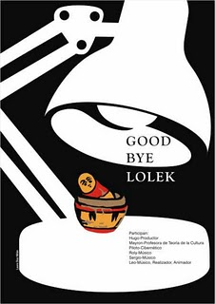
Good bye, Lolek

Slide 19
The lack of alternative options in television for Cuban children between the sixties to the eighties, along with the educational purpose of Cuban television, contributed to a massive consumption of Soviet cartoons. For the sentimental Soviet-Cuban imagined community, these cartoons’ songs, stories and phrases are familiar and constituted part of their cultural background. These references are functional only for the members of what I call the sentimental Soviet-Cuban community. All these referents: phrases, words, images have been now incorporated into the Cuban artistic production.

Slide 20
The Soviet appliances that have survived more than 20 years after the end of the Soviet Union provide a social stratification that shows who was left out of the new market relations in post–socialist Cuba and who was unable to insert himself in this new dynamic. At the same time, these objects provide a reading of an equalitarian society that does not exist anymore. In the 70s and 80s, mainly, Cuban homes resembled each other because of the peculiar market system where the appliances and almost every single object in the house were to be assigned based on working or political merits. This resemblance provided a reading of the Cuban society as a homogenous one, and at the same time offered a sense of stability and subjective belonging among citizens. But this stability and homogeneity found its end after the collapse of the Soviet Union and the profound economic crisis that has been affecting Cuban daily life since then.

Slide 21
The existence of a sentimental community, the Soviet–Cuban in this case, allows the association –imagined and virtual– of a group of persons bonded by a common affection toward Russian culture. These partnerships have adopted specific forms, such as online blogs and websites where the main subject is the Russian Cartoons and memories of Cuba’s past.

Slide 22
Some of these blogs:
Verde Caimán
Nuestra infancia en Cuba
Recuerdos de muñequitos rusos
Añoranza por los muñequitos rusos
Fanáticos de los muñequitos rusos
Muñequitos rusos (etc)

Slide 24
The expo provides a new reading of the relation between Cuba and Russian culture. This new reading has lost any political and ideological meaning and allows a necessary reconciliation with the Cuba’s Soviet past and the recognition of its impact on Cuban identity.

Slide 25
The new dynamic in which Cuban culture was immersed after the 90s made possible its revitalization and provided a frame for a thematic emergence without precedents. In this context, the Soviet past of Cuba emerged as a new aesthetic in which we can find traces of a new Cuban identity, unstable, in transition.

Slide 26
Stuart Hall has labeled as the production of identity: an identity rooted not on archeology but on the retelling, visits and reviews of the past. The exceptional circumstance of a “sovietized” tropical island offers an attractive place from which to base one of the possible narratives of the past.

Slide 27
The new relations that Cuba and Russia have been enforcing since the 2000s are possible, in large part because of the Soviet past of the island.

Slide 28
The Cuba’s Soviet past came about in a cultural space where it is able to project one of the many readings that Cuba’s present is having: that related to the Soviet period of Cuba. There is not an ideological nostalgia; this nostalgia is just the way adopted by the mourning of the end of a world. The end of this world, finally, has allowed the birth of multiple, unstable and personal worlds, one of them intrinsically related to the Soviet era in Cuba.

Slide 29
The authors working with this cultural heritage, in all its different manifestations: intertextuality, transliterations, references to objects , geographical locations, names, etc, etc, are recycling debris from a past whose physical and affective traces -like the matrioshka caught in the mousetrap of Alain Martinez- are the legacy of the Soviet presence in Cuba for over thirty years.

Slide 30
The reach of this sentimental Soviet-Cuban community, however, goes beyond the narrow chronological limits of these two decades and extend to include even the children of these generations, for whom the memories of the Soviet world in which their parents lived, arrive mainly through stories and anecdotes, and even artistic fictionalization of that world, and also, importantly, through objects that have survived the end of the Soviet presence in Cuba.

Slide 31
After three decades of strong relationships between Cuba and the former Soviet Union from the sixties to the nineties, the end of the Soviet Empire took different ways in the social and cultural Cuban imaginary. Starting with the beginning of the new century, the Soviet, as the intangible representation of the past, became an aesthetic: in literature, in graphic arts, in music and even in cinema. The topic turned out to be a token of postmodernity in Cuba. Although we can find Cuban cultural products related to the Soviet reality before the end of the Soviet Empire, it is only after the 90s when the aesthetization of the Soviet objects and slavic emotional remnants allowed a de–sovietization of the Cuban society. At the end, the de–ideologization of the socialist past and its symbols permitted the deconstruction of the Soviet period of Cuba and the formation of affective references with more than one reading.

